Slide 1
Contact Information
Greg Searls
Executive Director
Counseling Compact Commission
info@counselingcompact.gov
https://counselingcompact.gov
https://compactconnect.org

Slide 2
The Interstate Counseling Compact: The Time is Near
Greg Searls
Executive Director
Counseling Compact Commission
Notes:
Disclosures not an attorney and not providing legal advice

Slide 3
Learning Objectives
Participants will be able to:
Describe the requirements to participate in the compact and how to apply for privileges
Identify which states are members of the Counseling Compact
Explain some of the ethical and legal issues associated with the Compact to determine if the licensee should participate in the compact
The Time is Near

Slide 4
Presentation Overview
Part II: Privileges 101
Part IV: Questions and Answers
Part III: Demonstration
Part I: Counseling Compact Commission
The Time is Near

Slide 5
Counseling Compact Commission

Slide 6
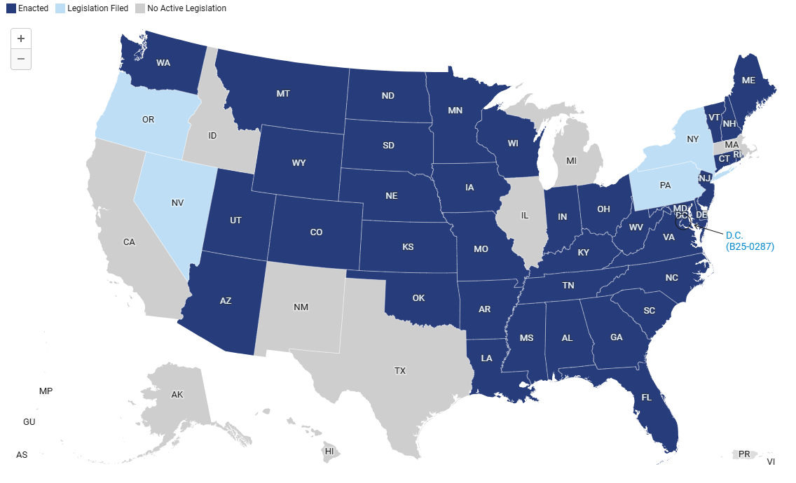
The Time is Near

Slide 7
What is the Counseling Compact?
Addresses heightened demand for counseling services
Facilitates interstate practice via a “privilege” through mutual recognition model
Builds on current reciprocity systems
Rulemaking authority granted in legislation and limited by the same legislation
The Time is Near

Slide 8
Powers of the Commission
Establish bylaws
Impose fees to cover costs of the operations and activities of the Commission and staff
Maintain its fiscal records
Meet and take actions consistent with the provisions of the Compact
Promulgate rules within the authority of the Compact
Establish a budget
Establish and elect an Executive Committee
Others as defined in Section 9 C of the Compact Language
The Time is Near

Slide 9
Delegates
One Delegate per member jurisdiction.
Each member state licensing board or agency elects its delegate to serve on behalf of the state.
States may also name a Temporary Representative to serve in the absence of the Delegate.
The Time is Near

Slide 10
Committees
Executive Committee – 7 Delegates who are elected from the pool of Delegates. 4 Ex-Officio Members who represent major organizations within the Counseling Profession.
The Executive Committee appoints delegates to serve on the Finance, Rules, Compliance, and Election Committees. Temporary Representatives may also serve on Committees.
All Commission and Committee meetings are open to the public. Meeting information is available at https://counselingcompact.gov.
The Time is Near

Slide 11
Commission Meetings
Full Commission – Met February 12, 2025, Myrtle Beach, SC. Required to meet annually.
Executive Committee – Meets the first Wednesday of every month at 1:00 p.m. E.T. for 90 minutes.
Finance Committee – Meets the second Wednesday of every month at 1:00 p.m. E.T. for one hour.
Rules Committee – Meets the fourth Thursday of every month at 12:00 noon E.T. for 90 minutes.
Compliance Committee – Meets the first Monday of each month (unless it is a holiday) at 12:00 noon for one hour.
*All meetings are open to the public.
The Time is Near

Slide 12
Why the Counseling Compact?
Increases access to counseling services
Expands market opportunities
Supports military families
Facilitates telehealth but also allows in-person care
Counselor credentials transportable between member states
Promotes cooperation among Compact member states
Provides consumer protection across state lines
The Time is Near

Slide 13
Privileges 101

Slide 14
Image courtesy of Alpha Stock Images - http://alphastockimages.com/
The Time is Near
Notes:
Discuss documentation requirements, differences in state laws, emergency plans, mandatory reporting. scope of practice, billing and insurance, Medicaid and Medicare, liability insurance

Slide 15
Eligibility for Privileges
Live in a member state and hold a license in the same state.
60 semester-hour (or 90 quarter-hour) master’s degree in counseling or 60 semester-hours (or 90 quarter-hours) of graduate coursework in required areas.
Postgraduate Supervised Experience
Examination
Federal Criminal Background Check
No discipline against any license or privilege within the previous two years.
The Time is Near

Slide 16
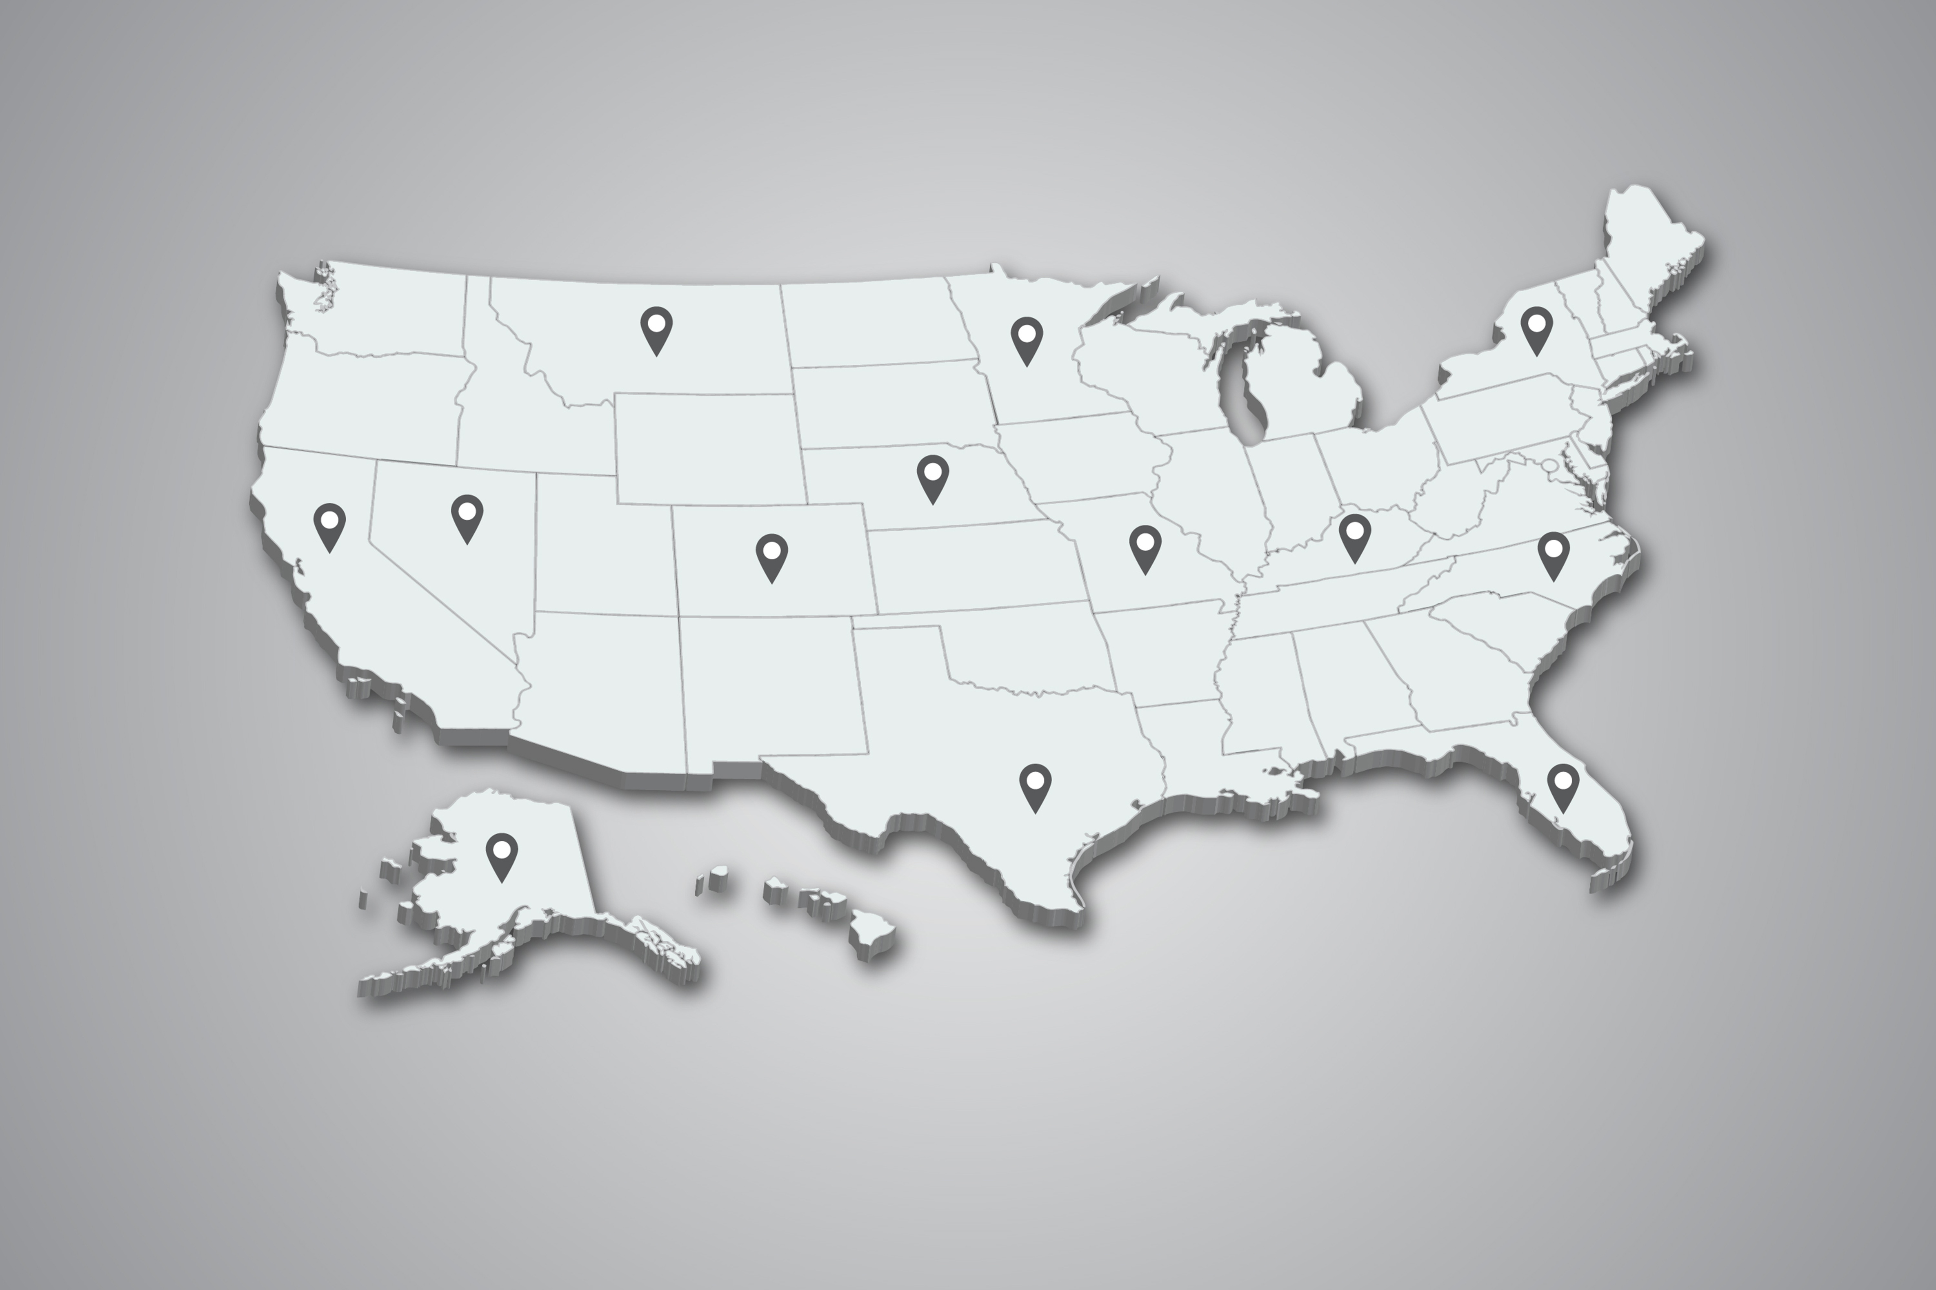
Where do I need a privilege?
The Time is Near
Notes:
Home state vs remote state

Slide 17
How will you obtain a privilege?
FBI CBC
complete a background check
Pay State Fee
Receive Privilege to Practice
Valid LPC License in home state that is a member of the CCC
Jurisprudence complete jurisprudence requirements in states that require it
Pay CCC Fee
per privilege to practice
Start Practicing
in remote state(s)
The Time is Near
Notes:
TN July 18, 2025 to set fees.

Slide 18
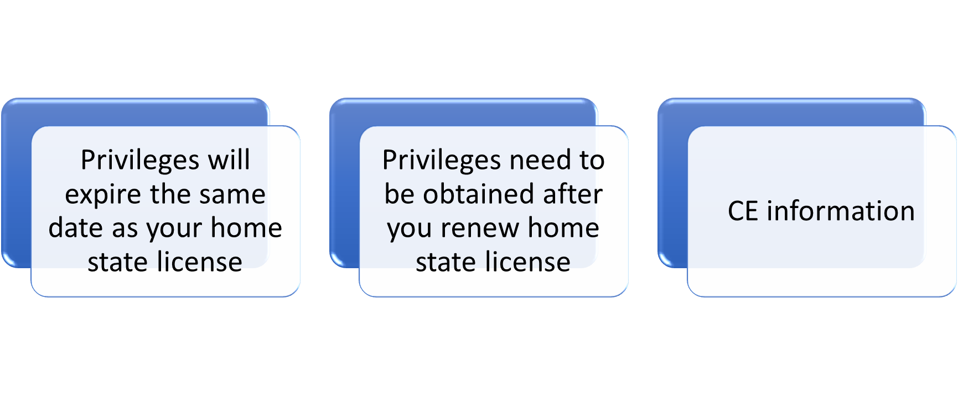
The Time is Near

Slide 19
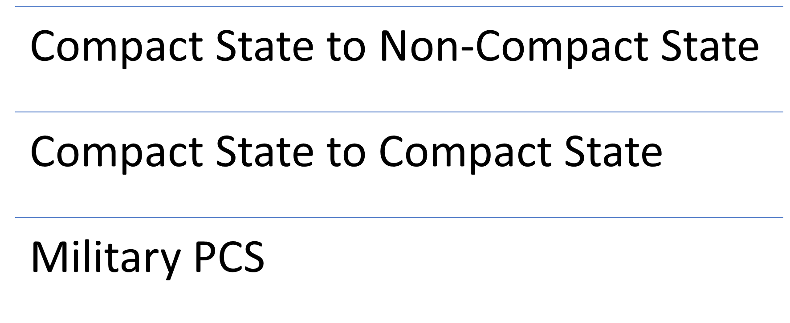
Home State Change and Military Provisions
The Time is Near

Slide 20
Disciplinary Action
Home State
Privilege State
Privileges are automatically revoked.
States are notified of action against the license.
Privilege in state where action taken is revoked.
Home state and states where a privilege is held are notified of the action.
Those states can seek information regarding the matter and discipline.
The Time is Near

Slide 21
Demonstration

Slide 22
You have a privilege, now what?
Practice under the laws, regulations, and scope of practice as legally allowed where the client is at the time of services.
Privileges expire based upon the expiration date of your home state license.
No state-specific CEU requirements to maintain a privilege. Maintain your Home State License
Seek the continued privilege after your home state license has been renewed and information uploaded to the Compact database.
The Time is Near

Slide 23
Contact Information
Greg Searls
Executive Director
Counseling Compact Commission
info@counselingcompact.gov
https://counselingcompact.gov
https://compactconnect.org

Slide 24
Frequently Asked Questions
My license was issued before the current exam/hours requirements were in place. Can I participate?
I have a license in the state where I work, not the state where I live. Can I use that license?
My home state isn’t a compact member, but I have a license in a state that is a member. Can I use that license?
The Time is Near

Slide 25
Questions and Answers
The Time is Near

